Slide 1

Capstone Final
Presentation
Jupiter Kang
Crystal Kao
Alonso Romero

Slide 2

Purpose
Food waste in U.S. public schools results in 530,000 tons of food discarded annually, equalling $1.2 billion in losses.
Fairfax County Public Schools (FCPS) in Virginia seeks to address this issue by leveraging data-driven insights to optimize their food service operations.
Data from March 2025 - May 2025 on all FCPS was provided
Goal:
A recommendation list of foods in order to optimize the spending by creating a customized budget that is more efficient and data driven, with breakdowns by region, school level, and individual schools.
Conclusion:
The optimization model proposes $1,825,539.30 in savings if items are acquired according to suggested quantities

Slide 3
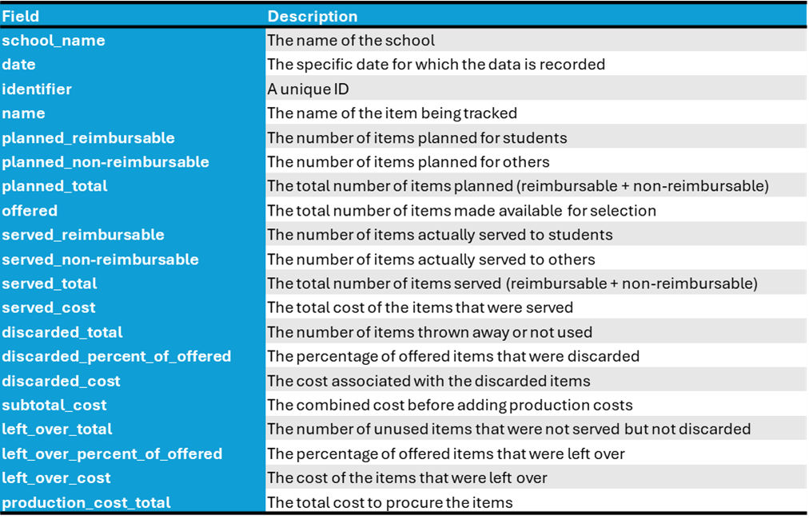
Data
Data_breakfast.csv / Data_lunch.csv
Date Range: May 2025
Data size: 191,757 rows / 20 columns
190 schools
411 distinct food items
Other data
data_breakfast_with_coordinates / lunch
Coordinate data, region, level
fcps_nutrition_values
Nutrition data for each item (calories, sugar, vitamins, etc.)
2022-2025 Fairfax County School Student Count
Count of students by school per school year
unit_costs.csv
Unit production cost for each item

Slide 4

Methodology
Steps:
Exploratory Data Analysis
Popularity Analysis
Optimization of Budget
Regression for Predictability
Time series analysis and LSTM

Slide 5
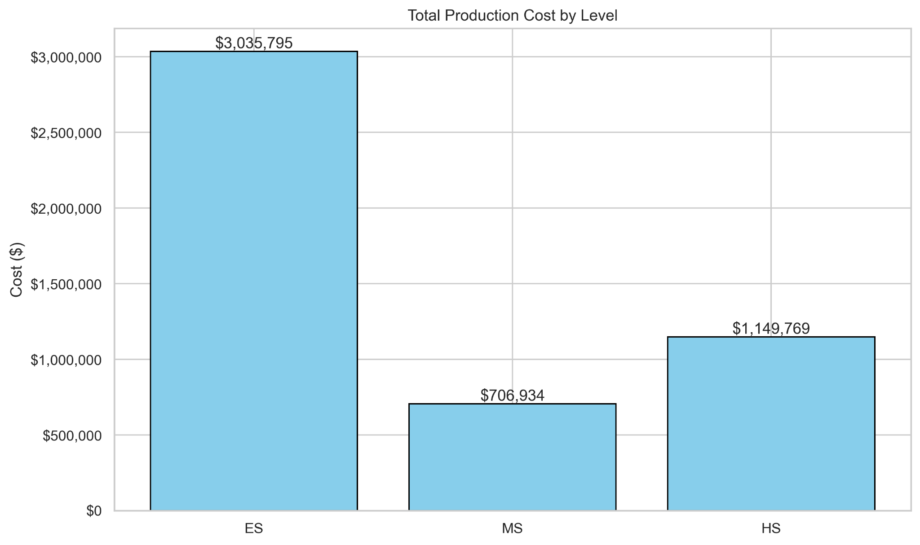
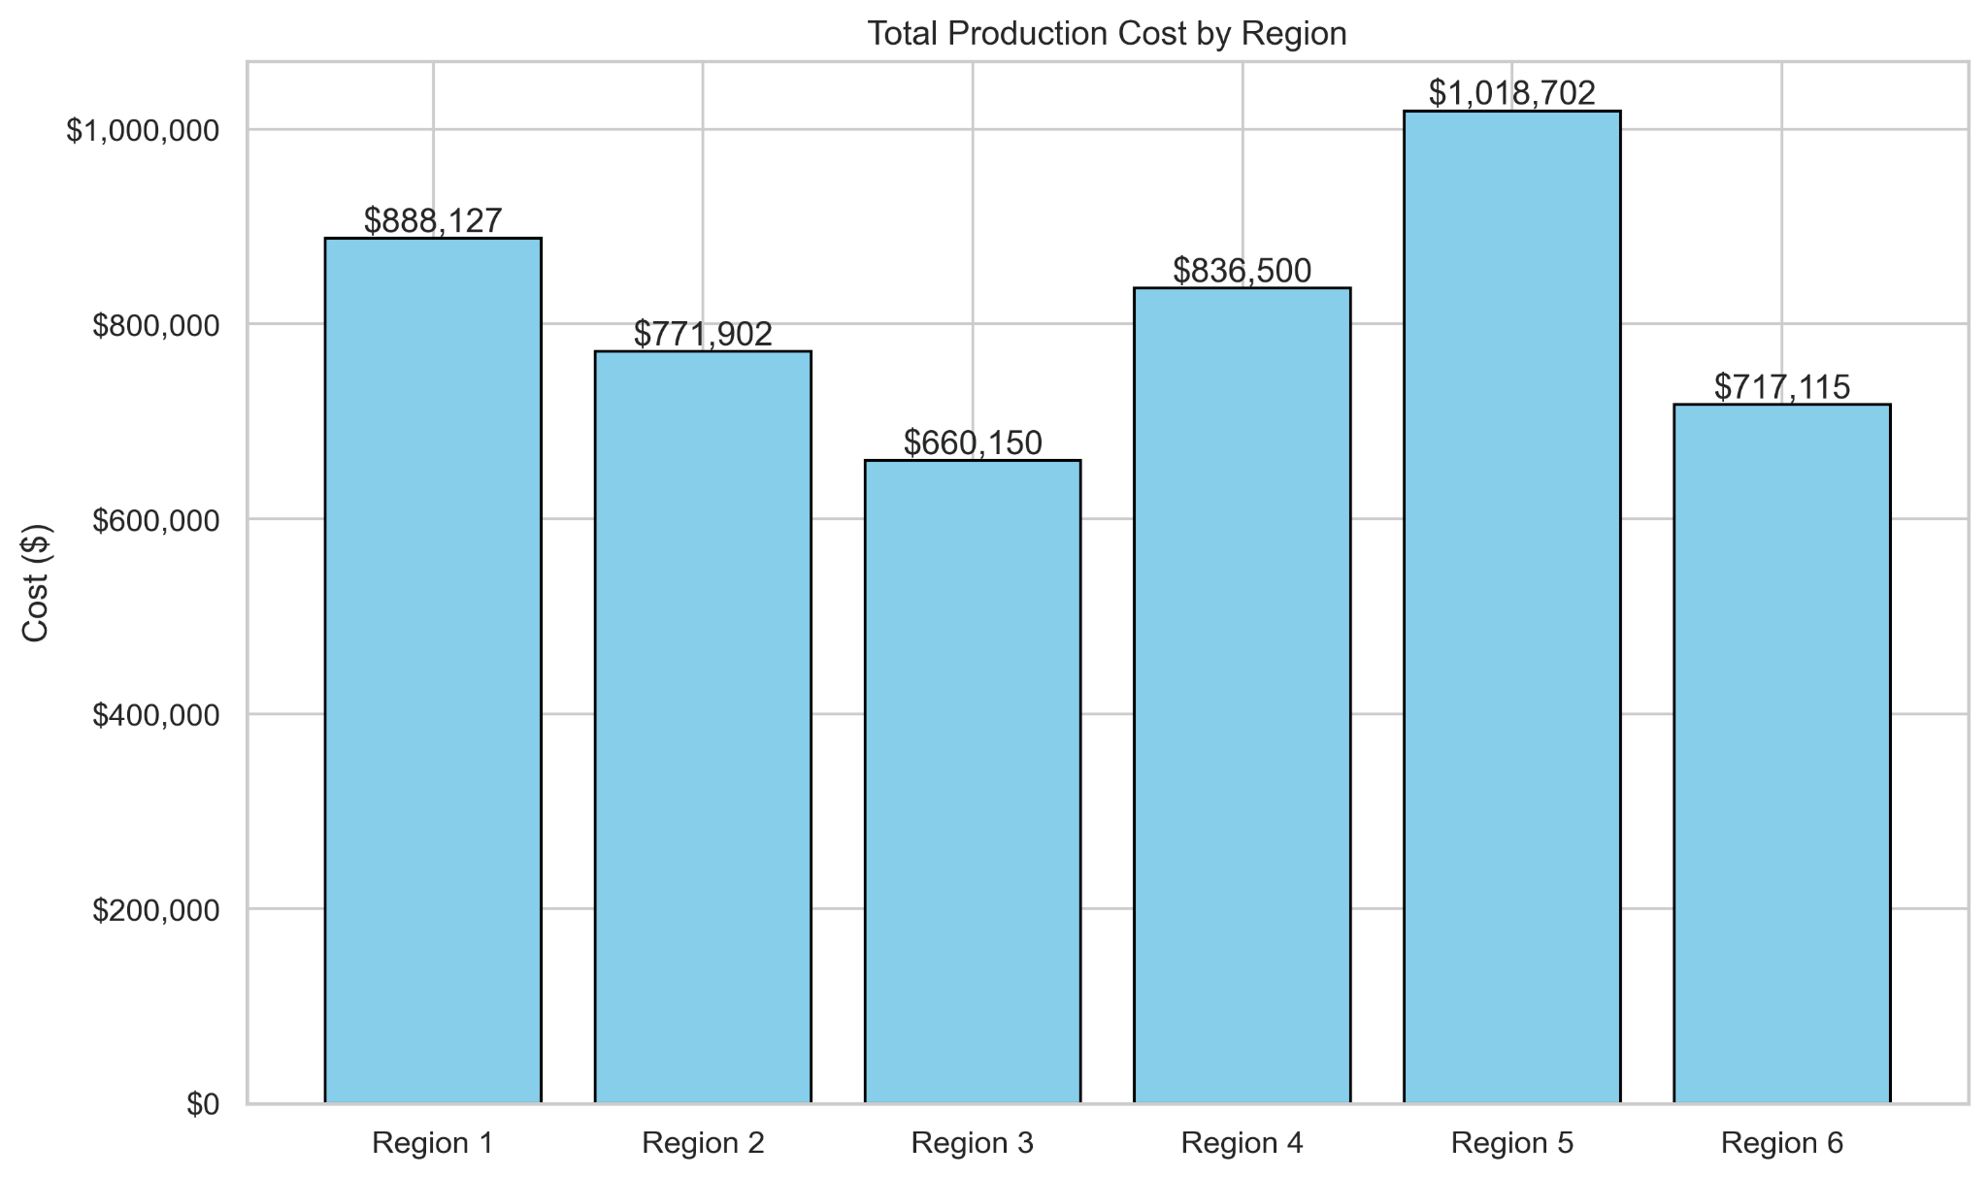
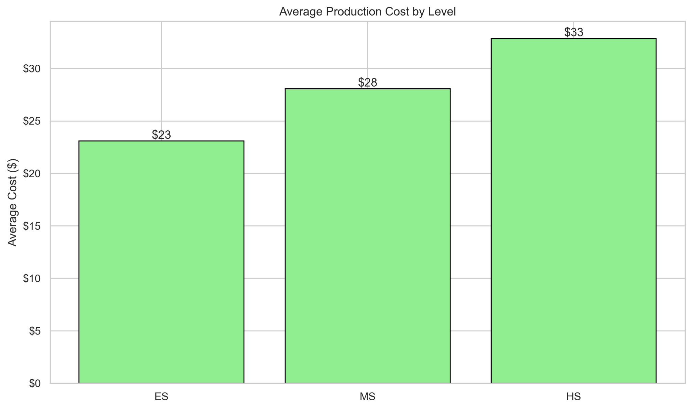
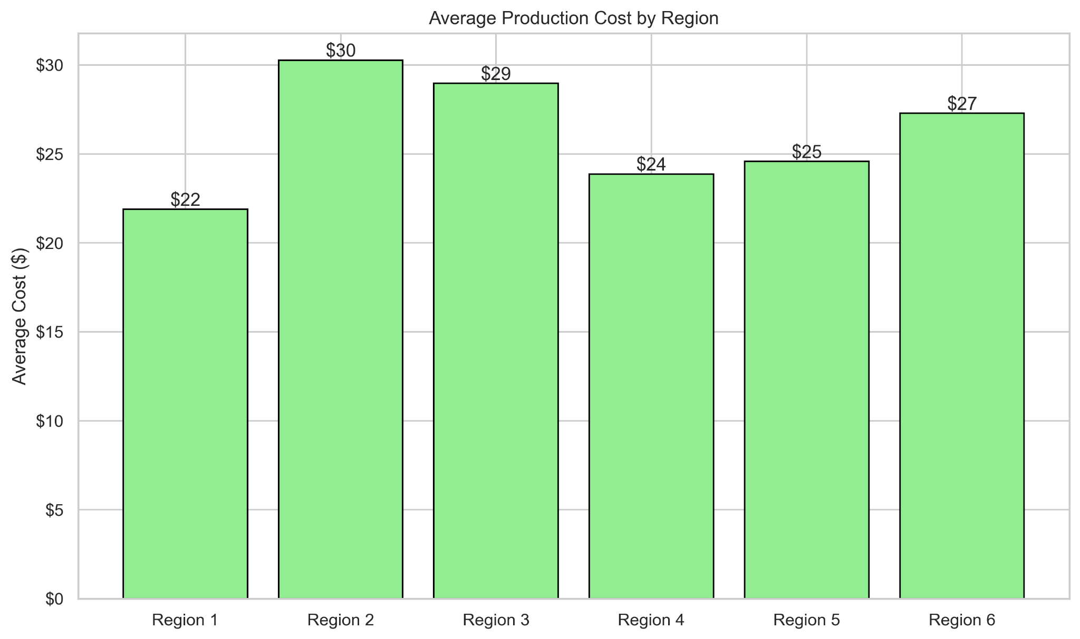
Exploratory Data Analysis

Slide 6

Popularity
Based on consumption and amount left over/discarded
Consumption
Used to rank popularity
(Total Offered - Total Leftover) / Total Offered
Results:
Breakfast: Apple Juice, Orange Tangerine Juice, Mini Maple Pancakes, 1% White Milk, Bagel
Lunch: Fat Free Chocolate Milk, Lettuce Blend Salad Mix, Ketchup Packets, Apple Slices, Ranch Dressing
Leftover Rate
Identifies which items with the highest waste
Total Leftover / Total Offered
Results
Breakfast: Fat Free Chocolate Milk (98.83%), Cereal Cinnamon Toasters (60.26%), Fat Free White Milk (53.49%)
Lunch: Fat Free White Milk (60.63%), Lactose Free Milk (50.90%), 1% White Milk (50.83%)

Slide 7
Regression
Dataset
data_breakfast_with_coordinates.csv
data_lunch_with_coordinates.csv
School_Regions.geojson
2022-2025 Fairfax County School Student Count
Method - OLS
Dependent variable: production_cost
Independent variables:
planned_total, served_total, discarded_total, left_over_total, student_count
Using more operational variables to reduce the effect of multicollinearity

Slide 8
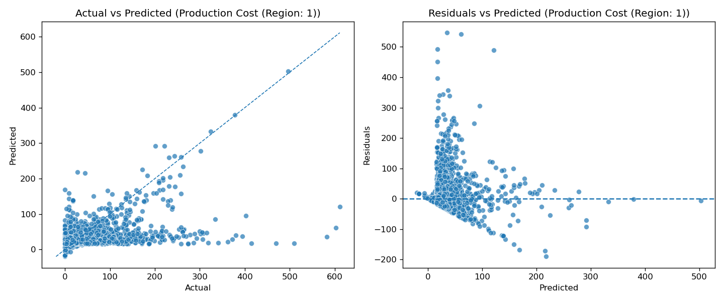
Regression
Region | Adj R^2
1 | 0.054
2 | 0.268
3 | 0.228
4 | 0.268
5 | 0.150
6 | 0.263
Actual VS predicted (Production Cost (Region: 2))
Residuals VS predicted (Production Cost (Region: 2))
Notes:
Max 5 mins

Slide 9
Regression
Dataset
Method - OLS
Dependent variable: production_cost
Independent variables
Future pathway
Add ratio variables
served_total / planned_total: execution rate
Normalizing scalers
Cost per meal
Ratio based factor for better prediction

Slide 10
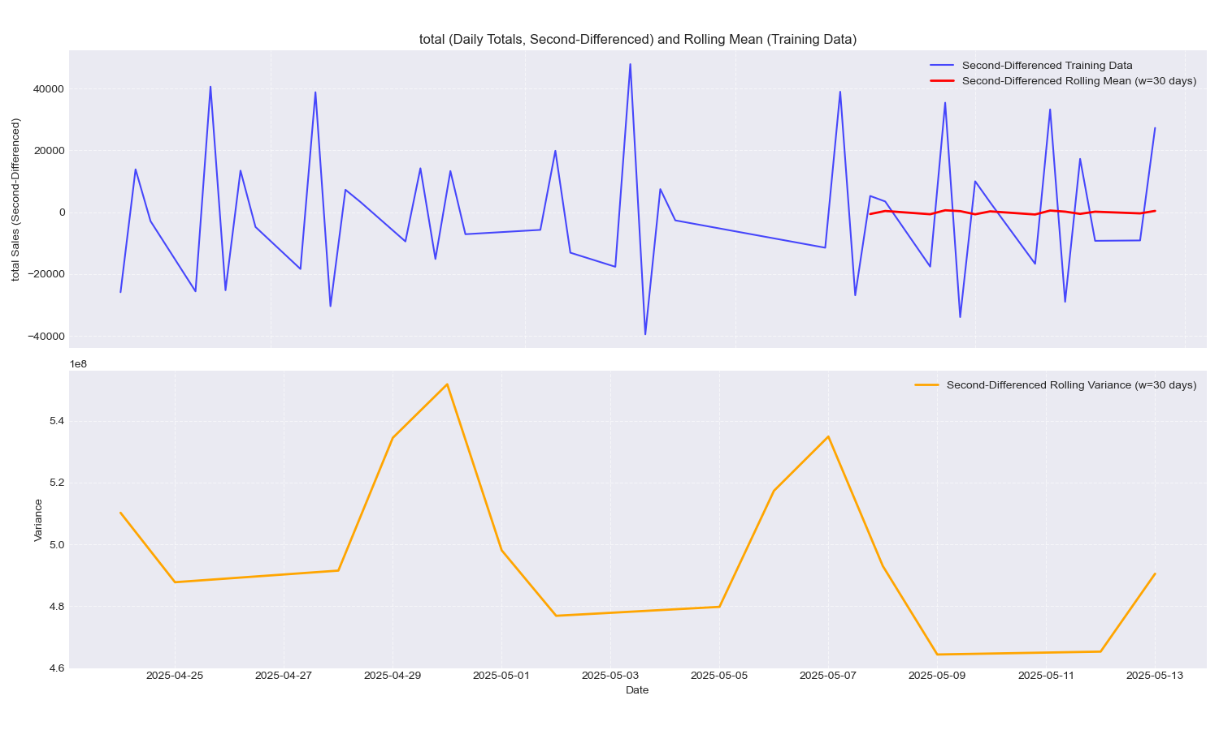
Time Series Analysis
Dataset
sales.csv
Stationarity
Rolling mean and variance
ADF & KPSS test
Differencing
Order for AR, MA
Non-seasonal:
p=q=d=1
Seasonal:
P=Q=D=1
S=7 for weekly pattern
Lack of data points

Slide 11
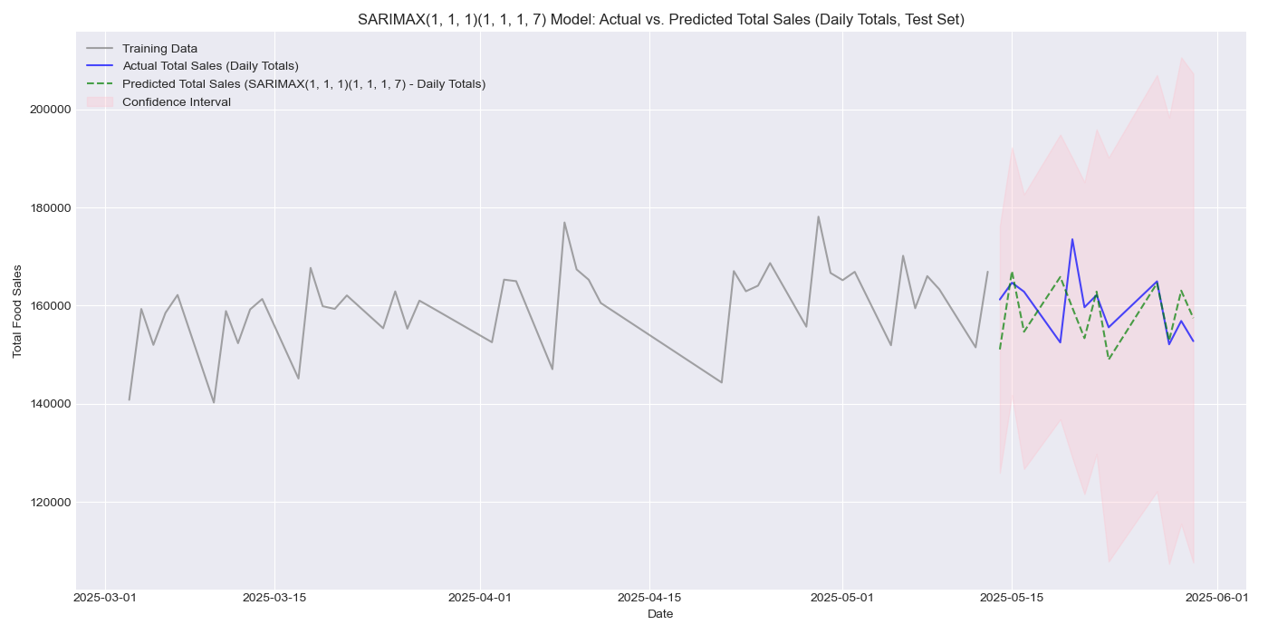
SARIMA model
Notes:
Max 5 mins

Slide 12
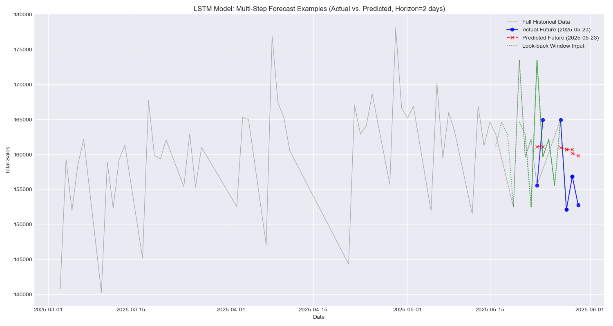
LSTM Neural network
look_back = 7
Using previous 7 days of data
forecast_horizontal = 2
2-step ahead
Notes:
Max 5 mins

Slide 13
Optimization
Mixed-Integer Linear Programming (MILP)
Mathematical method used to determine the best possible outcome where the objective and constraints are linear but the variables must be integer values.
Components of the model:
Decision Variables: The unknown quantities that the model determines to solve the problem. Represents discrete counts and cannot be fractions.
Objective Function: Linear mathematical formula that defines the goal of the model.
Linear Constraints: Restrictions or logical limits placed on the decision variables.
Feasible Region: Set of all possible solutions that satisfies every constraint in the model.

Slide 14
Optimization:
Decision Variables
“How many food items do we produce?”
The variable that the MILP solver is trying to figure out.
Given:
Goal: Minimize Cost + Waste
Constraints: Budgetary, Production, Integer

Slide 15
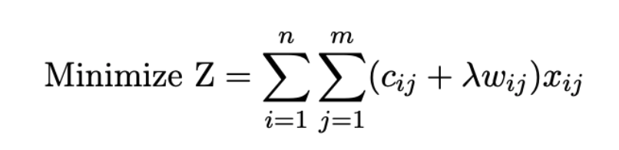
Optimization:
Objective Function
Goal to make the total Z as small as possible
Double summation: iterating through schools and meal types
Cost: Unit production cost
Waste Penalty: Adds a secondary cost to every unit produced, mathematically inflates the cost, discouraging overproduction of high waste items even if their base cost is low
Lambda: 0.1
Decision Variable: Quantity of items to produce for school i for meal type j

Slide 16
Optimization:
Linear Constraints
Financial Constraint
Enforces a specific budget range for each individual school. Prevents the model from “starving” one school to feed another just to save money
Overall Annual Budget: $139,144,760
Production Bounds
Prevents the model to produce unrealistic amounts, must stay with a range based on historical demand
Integer Constraint
Prevents solver from returning fractions

Slide 17
Optimization:
Feasible Region
Financial Constraint
The total cost must be less than the school’s allocated budget
Production Bounds
Size-based production bounds
For example: For 1000-1499 =
(0.90, 1.10)
The model cannot produce fewer than 90 meals or more than 110 meals for example

Slide 18
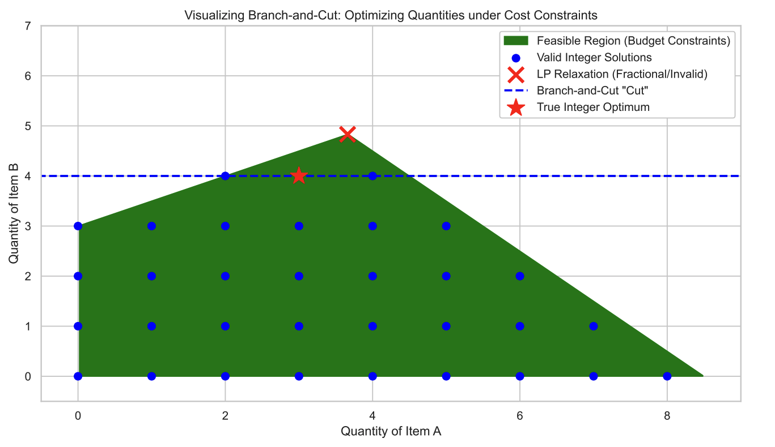
Optimization:
Feasible Region
Integrality
Forces the solution to round up from one whole number to the next, ignoring all decimals
Branch-and-Cut Algorithm

Slide 19
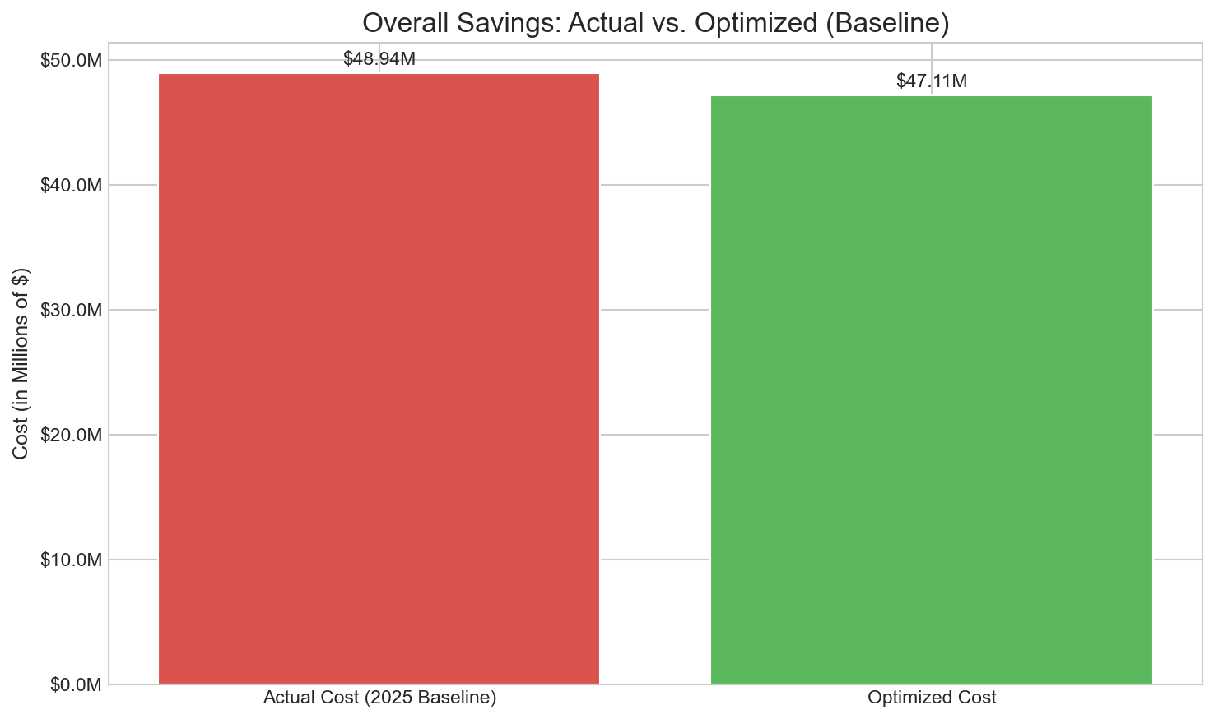
Optimization: Results
Financial Results
Baseline (Actual) Annual Cost: $48,936,842.30
Optimized Annual Food Cost: $47,111,303.00
Annual Savings: $ 1,825,539.30

Slide 20
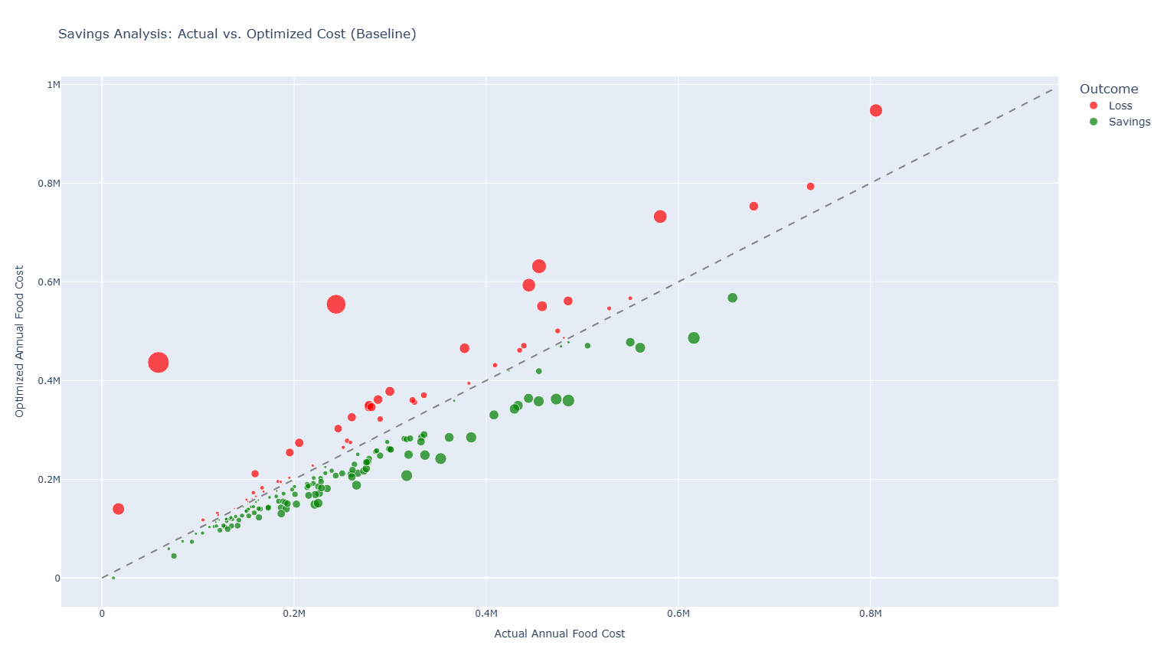
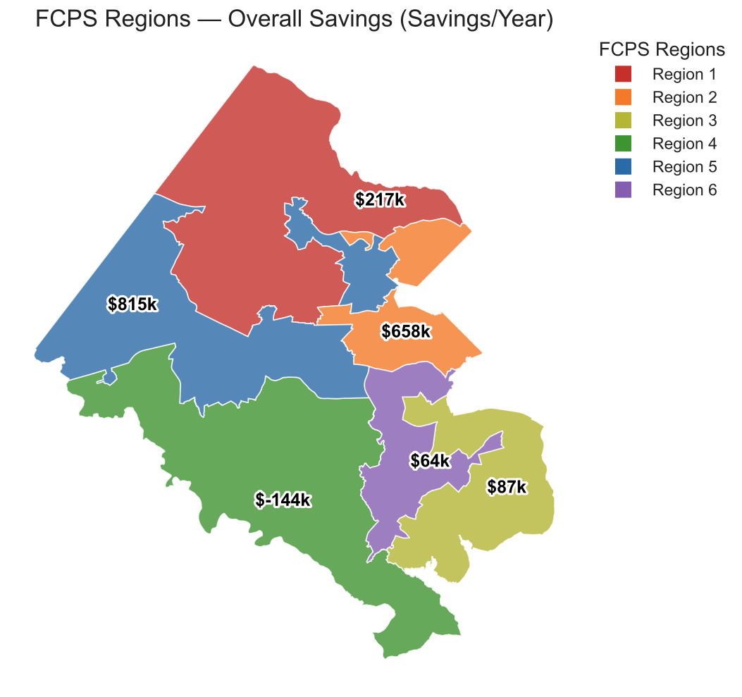
Optimization: Results - Savings Analysis
Actual - Optimized = Savings/loss
130 Schools saving, 60 at a loss
Region with loss: Region 4
Lake Braddock, Robinson Sec.

Slide 21
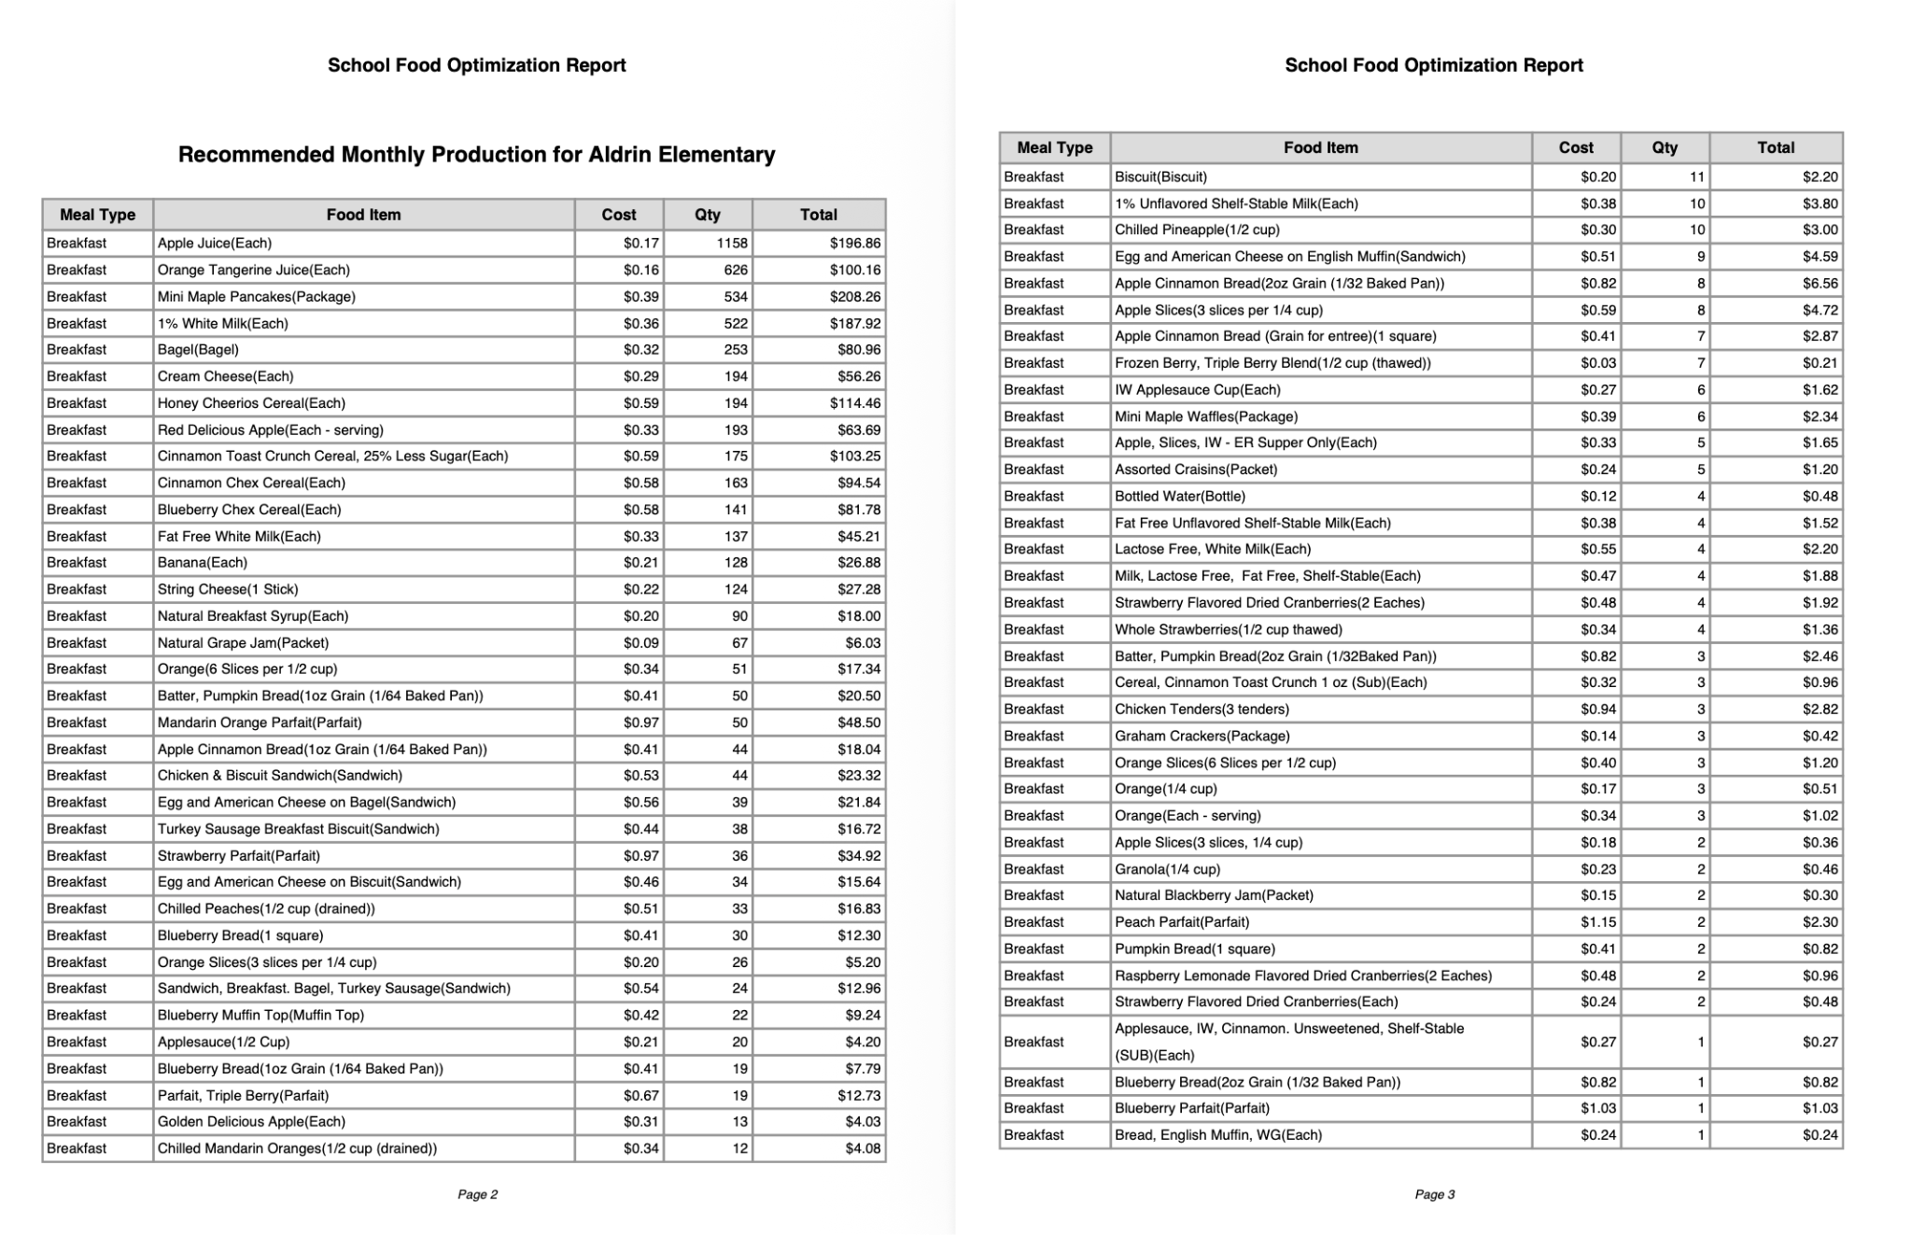
Optimization: Results - Recommendation
Generated from our UI
Provides the quantity count for specified items for the month
Covers both breakfast and lunch

Slide 22

UI Demo

Slide 23

We recommend that FCPS follow the optimization results to maximize their savings while reducing waste, which can lead to $1,825,539.30 in savings
Conclusion

